Slide 1

REESE WILLIAMS
JOHN HOANG | OLIVER JANG | HENRY JIANG | HARMAN MINHAS

Slide 2

The Idea
Notes:
Problem/solution

Slide 3
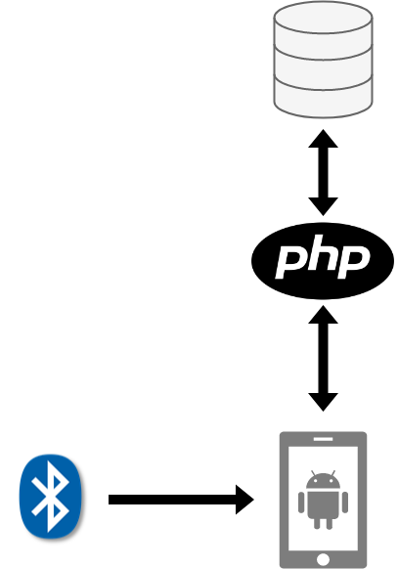


Solution design

Slide 4
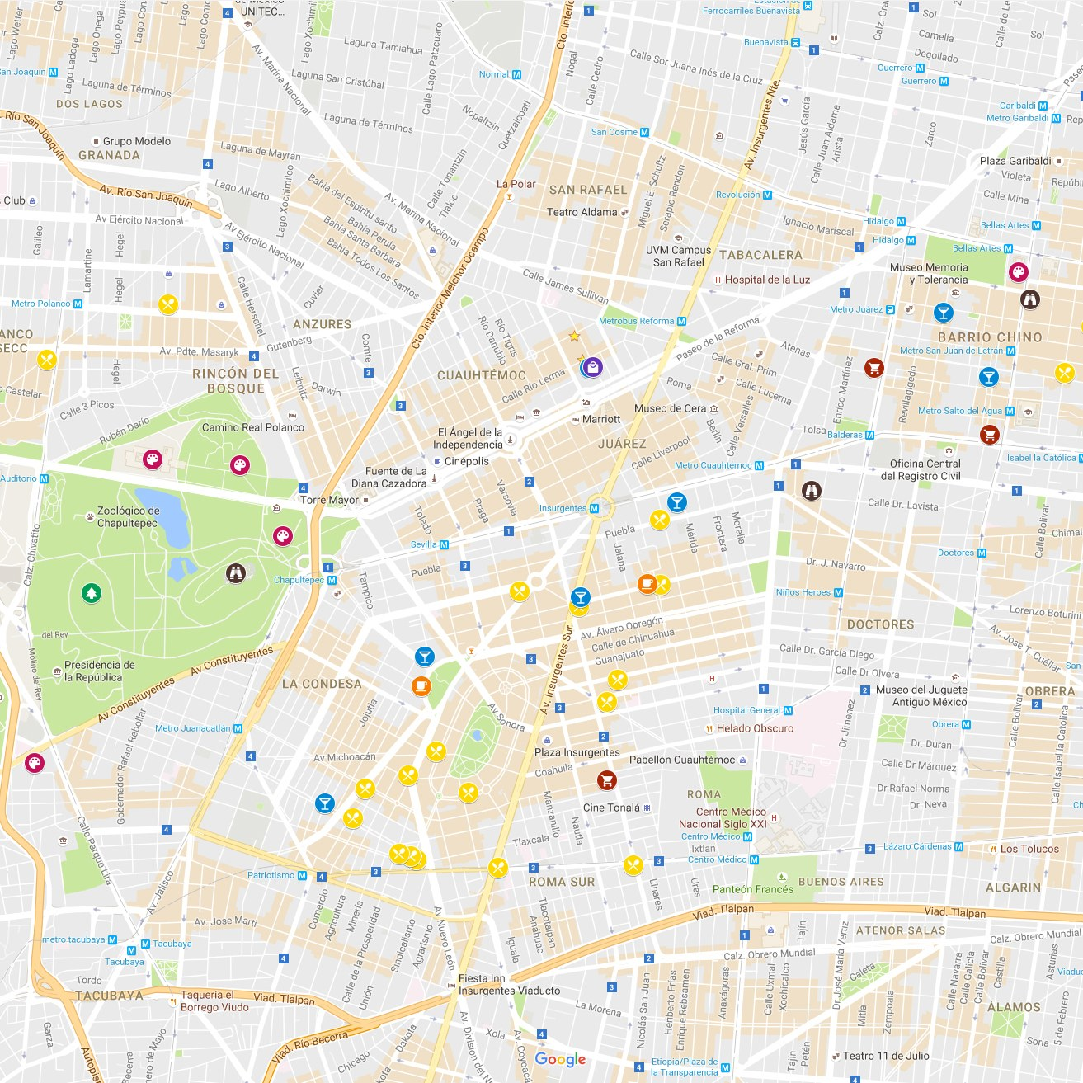



3900
user & business component
database backend
Proof of concept

Slide 5

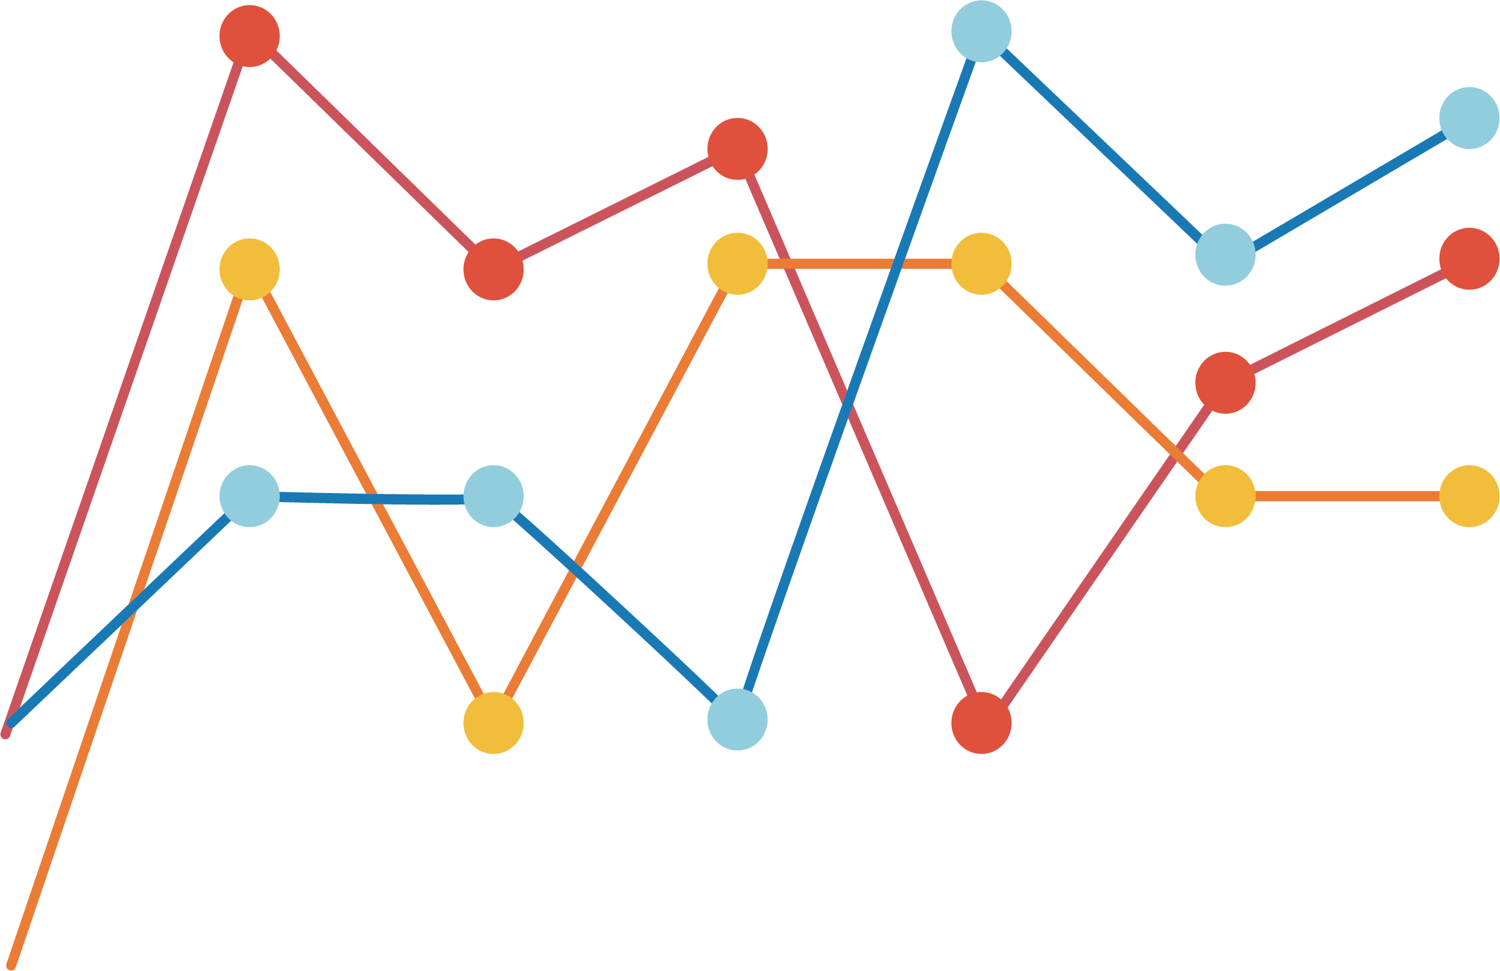
4900
Analytics & admin component
testing
guides
User interface
Artificial intelligence base

Slide 6
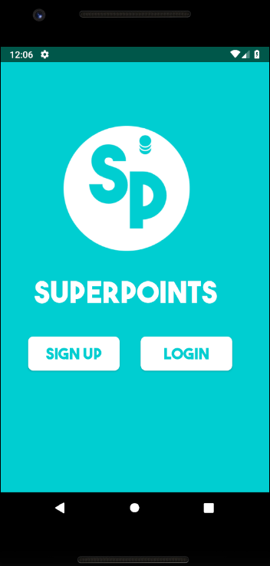
demo
Notes:
Problem/solution

Slide 7
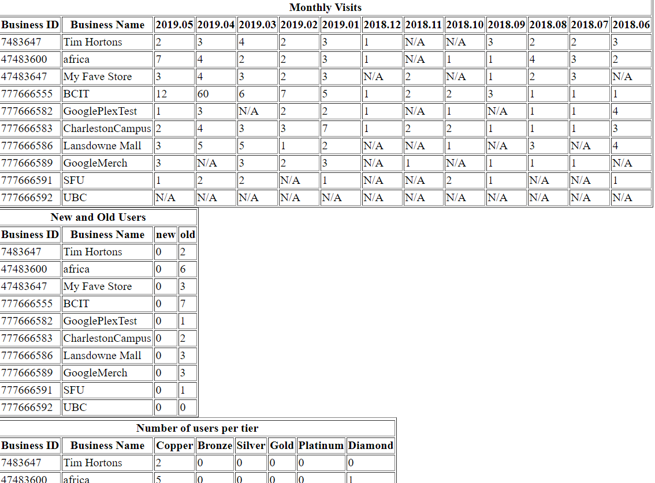
kpi

Slide 8


Slide 9

deliverables
Businesses can upload images for promotions
Monthly kpi report for administrator
Analytics: total visitors/month, new vs. old customers, visitors/tier
Administrator component
User tiers
Miscellaneous visual changes
Minor functional changes
Aesthetic update
*there are A FEW KNOWN BUGS WITH ITEMS NOT LISTED HERE
Green = delivered orange = issues with delivery
Red = incomplete

Slide 10

testing
Done in pairs
Performed on parts not made by the pair
Application wide
Regression / unit / integration

Slide 11

The future
ai
Business plan

Slide 12
wbs
UI
ADMIN
USER
BUSINESS
DATABASE
ANALYTICS
AI
DOCUMENTATION

Slide 13
actuals

Slide 14

challenges
deployment
marketability
competition

Slide 15

Known bugs
Inconsistent location updates
Auto login problem

Slide 17
?

